Slide 1
EUROPEAN SEMESTER 2024
Spring Package
EESC – European Semester Group – 28 June 2024
Brendan Garrec, COM/SG RECOVER

Slide 2
The 2024 European Semester Spring Package
Spring Package Chapeau Communication
Outlines main economic and social policy priorities for next year
Economic, Social and Employment Policy Coordination
Country reports
Take stock of the specific socio-economic challenges in every Member State
Commission proposals for country-specific recommendations
Address key challenges not or not sufficiently addressed by the RRPs
Employment Policy Coordination
Proposal for a Council Decision on guidelines for the employment policies of the Member States
Guides national employment policies - to be drawn up every year (Art. 148 (2) TFEU)
Fiscal Policy Coordination
The Omnibus report (Art 126(3)) and fiscal statistical tables
Prepared for 12 Member States that recorded a deficit above 3% in 2023
Post-programme surveillance reports (ES, CY, IE, EL and PT)
Assesses the economic, fiscal and financial situation of Member States that have benefited from financial assistance programmes

Slide 3
European Semester: 2024 Spring Package
The 2024 European Semester Spring Package focuses on:
Strengthening Competitiveness, calling on the EU and its Member States to take further steps to ensure long-term competitiveness.
Maximising the impact of EU funds, by making full use of their synergies and the complementarities of reforms and investments under the RRF and Cohesion Policy programmes, and giving guidance for Cohesion Policy mid-term review
Implementing the new economic governance framework, which will strengthen fiscal sustainability and support long-term sustainable and inclusive growth and resilience.
The policy priorities are structured around the four dimensions of competitive sustainability and in line with the Sustainable Development Goals.

Slide 4
Chapeau Communication
Overview of the economic and social policy priorities in this European Semester
Particular attention for challenges linked to competitiveness, including low productivity growth, weak investment dynamics and high labour and skills shortages.
Highlights major common and country-specific challenges along the four pillars of competitive sustainability: Macroeconomic stability, Productivity, Environmental sustainability, and Fairness
Calls on Member States to address delays and structural challenges in the implementation of RRPs and cohesion policy programmes.
Acknowledges adoption of REPowerEU chapters while pointing to the need for action in areas like energy supplies, net-zero industries and climate adaptation.
Provides an overview of the revised EU economic governance framework and an update on surveillance under the SGP and macroeconomic imbalances in the Member States
Describes the robust employment situation while acknowledging social and regional disparities and challenges to upward social convergence.

Slide 5
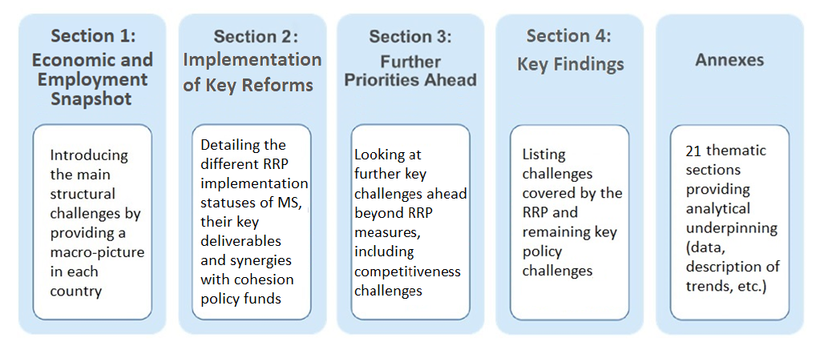
Country Reports
Country Reports analytically underpin the 2024 country-specific recommendations (CSRs). They identify country-specific vulnerabilities and priority reform and investment challenges.

Slide 6
2024 CSRs
Similar to last years, only limited set of recommendations, taking into account measures covered in the RRPs.
The recommendations are divided into:
Recommendation on fiscal policy, including fiscal and fiscal-structural reforms, and in some cases also to address macroeconomic imbalances;
Recommendation to continue or accelerate implementation of the RRP, including its REPowerEU chapter, depending on MS progress; to swiftly implement the cohesion policy programmes; and to take advantage of the related opportunities provided by STEP.
Recommendation(s) on key challenges beyond the RRPs to be addressed with a strong focus on competitiveness.

Slide 7
CSRs: Competitiveness
Member States are recommended to address a wide range of policy issues affecting competitiveness, notably with regards to:
Business environment: better access to finance and lowering administrative burden
Research and Innovation: enable business-friendly environment to encourage investment
Labour market policies: tackle labour market shortages
Skills and Training: address skills mismatches
Education: address education performance challenges, and improve basic skills levels and inclusive education
Energy and Resource Efficiency: targeted recommendations going beyond the REPowerEU chapters

Slide 8
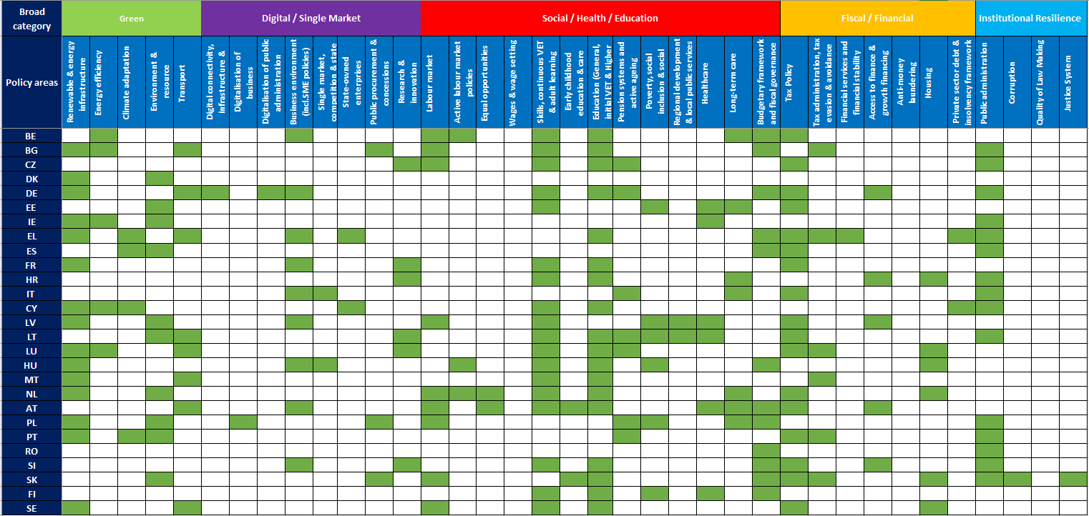
Overview of the thematic areas covered in the CSRs

Slide 9
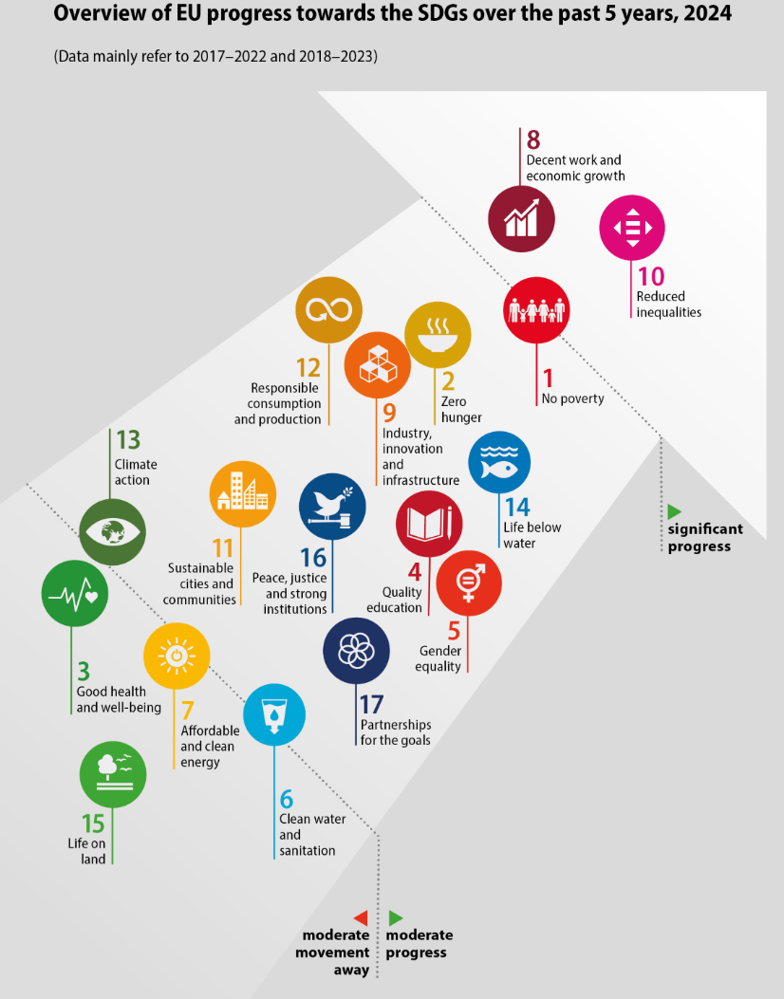
Sustainable Development Goals (SDGs)
As in previous cycles, the Semester integrates SDGs policy objectives.
The 2024 Spring Package:
Parallel release of Eurostat 2024 “Monitoring report on progress towards the SDGs in an EU context”.
Country Reports: analysis in the narrative and dedicated annex on progress made in the past five years in the MS structured around the four areas of competitive sustainability. References to relevant SDGs in all other annexes.
CSRs: the RRPs implementation is expected to contribute to SDGs. RRPs Council Implementing Decisions include analysis on expected contribution to SDGs.
Chapeau communication: progress at EU level – most notably on reducing inequalities (SDG 10), ensuring decent work and economic growth (SDG 8) and reducing poverty (SDG 1).

Slide 10
Fiscal Policy coordination

Slide 11
Context to fiscal surveillance in spring 2024
Until end-2023: general escape clause, huge level of uncertainty
Excessive deficit procedure (EDP) to be opened in spring 2024
Reform of the economic governance framework: the new rules entered into force on 30 April 2024!
spring fiscal package reflects the new rules
rules for the deficit criterion of the EDP largely unchanged

Slide 12
Fiscal package spring 2024
1. Qualitative fiscal recommendations for all Member States:
A procedural part, to submit the medium-term fiscal-structural plan in a timely manner
A qualitative part, to limit the growth in net expenditure in 2025 to a rate that puts the government debt ratio on a plausible downward path over the medium term (…)
2. Romania: recommendation for the Council to establish that no effective action has been taken to reduce the excessive deficit (Art. 126(8))
3. Excessive Deficit Procedure: Report under Art. 126(3) = first step to open new EDPs
Subject to EFC opinion, EDP to be opened for Belgium, France, Italy, Hungary, Malta, Poland and Slovakia.

Slide 13
Excessive Deficit Procedure: decision tree
General government deficit < 3% of GDP
Deficit criterion fulfilled
Excessive deficit exceptional, temporary and close to the reference value
Deficit criterion met at face value
Assessment of compliance with the deficit criterion
STEP 1: assessment at face value
Further check if relevant factors can be taken into account
Relevant factors always taken into account
Relevant factors taken into account only if double condition is met
STEP 2: assessment of relevant factors
YES
NO
YES
NO
Debt-to-GDP < 60%
Debt-to-GDP > 60%
Double condition: excess deficit ‘close to’ and temporary

Slide 14
Next steps in fiscal surveillance (EDP in red)
19 June 2024
Spring package:
126(3) Omnibus report
proposal for 126(8) decision for RO on no effective action
21 June
COM issues:
guidance on content of medium-term plans to MS/EFC (MTPs)
Reference trajectories / technical information
End June
Economic and Financial Committee (EFC) adopts 126(4) opinion
July
COM intends to issue:
126(5) opinions
proposals for Council 126(6) decisions on existence of excessive deficit
16 July
ECOFIN expected to adopt:
126(6) decisions
126(8) for RO
20 September
Member States submit medium-term plans
15 October
Euro area Member States
submit 2025 Draft Budgetary Plans
Early November
Commission autumn forecast
November
Autumn package:
proposals for Council recommendations on the medium-term plans
opinions on 2025 Draft Budgetary Plans
recommendations to correct excessive deficit (126(7)), incl. for RO
December
ECOFIN expected to adopt:
recommendations on the medium-term plans
EDP 126(7) recommendations, incl. for RO
Coherent fiscal package

Slide 15
Macroeconomic Imbalances Procedure

Slide 16
Macroeconomic imbalance procedure:
General approach and impact of the EGR
The classification of imbalances is based on three criteria:
Gravity of imbalances
Evolution of imbalances, including prospects
Policy response
Forward-looking approach: more emphasis on evolution of risks and on policy response by Member States
Clarified the roles of the MIP and the SGP following the EGR: where risks are essentially rooted in fiscal sustainability concerns, the reformed SGP should be regarded as the appropriate surveillance tool

Slide 17
Macroeconomic imbalance procedure:
Classification outcome
In-depths reviews carried out for 12 Member States
The evolution of vulnerabilities has been diverse across countries but in many cases vulnerabilities have receded, as economic conditions adjusted to high – but falling – inflation.
A change in the classification of imbalances is justified in seven cases:
Spain, France, and Portugal were found not to be experiencing imbalance anymore.
Greece and Italy were changed from excessive imbalances to imbalances.
Slovakia is now found to be experiencing imbalances.
Romania is now found to be experiencing excessive imbalances.
The other five cases remain classified as imbalances (CY, DE, NL, HU, SE).

Slide 18
Employment and Social Policies

Slide 19
Employment and social priorities in the 2023 Semester Cycle
While employment, skills and social issues continue to be supported by RRF, ESF+ and other instruments in line with the European Pillar of Social Rights, CSRs are suggested in the area of:
Improving skills levels of adults (18)
Including a specific angle on labour and skills shortages / skills mismatches (13)
Improving education and basic skills (18)
Non-discrimination and equal opportunities (11), incl. childcare
also in adequate and sustainable social protection, healthcare and long-term care.

Slide 20
Social Convergence Framework (SCF)
Findings from the new SCF assessing risks and challenges to upward social convergence in Member States, reflected in country reports and CSRs (without automaticity):
The Second-stage analysis published by the Commission services in May 2024, which analysed in more detail seven Member States (BG, EE, ES, IT, LT, HU, RO), and fed into the multilateral reviews in the relevant committees of the Council.
These countries were selected based on the First-stage analysis, presented in the 2024 Joint Employment Report (JER), which analysed labour market, skills and social policies for all 27 Member States in order to identify potential risks to upward social convergence based on the Social Scoreboard.

Slide 21
Employment Guidelines 2024
The update provides EU-wide guidance to Member States for their employment, skills and social policies. Novelties include calls to:
Make progress on reaching their 2030 national targets on employment, skills and poverty reduction, next to EU level targets
Put in place actions to tackle skills and labour shortages, including basic and digital skills, legal migration
Implement policy initiatives of particular relevance, such as on platform work or affordable housing
Next steps:
Negotiations in the Employment and the Social Protection Committees
Opinions from the European Parliament, EESC, Committee of the Regions.
Final Council adoption envisaged for November 2024.
Support the uptake of new technologies, AI and algorithmic management

Slide 22
Thank You

